Slide 1
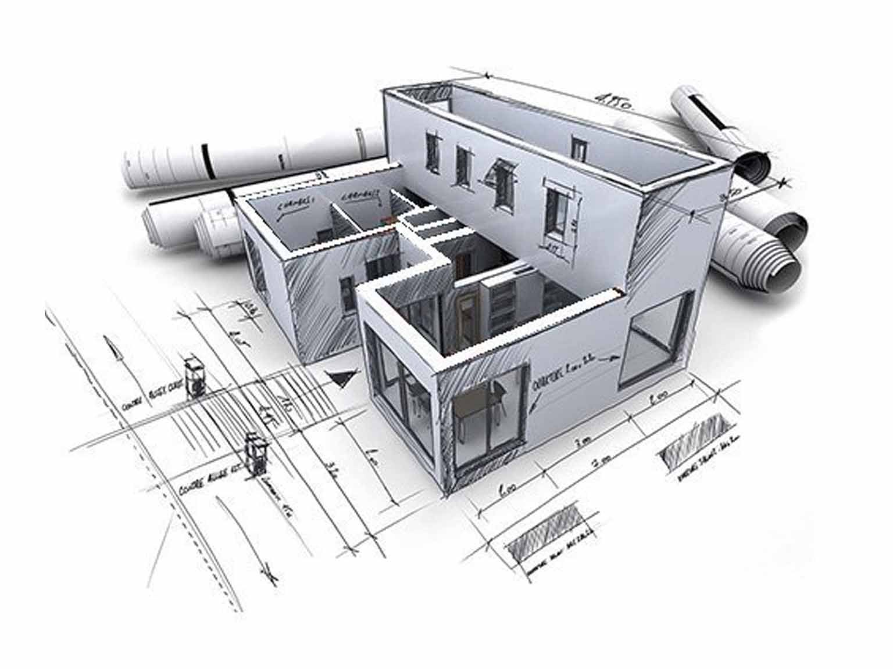

Lecture 1: Introduction to Engineering Drawing
EEE154 Engineering Drawing
Dr. Jilan Samiuddin (JSA)
Assistant Professor
North South University

Slide 2
Class Information
Course Name: Engineering Drawing
Course Code: EEE154
Credit Hours: 1
Pre-requisites: None

Slide 3
Instructor Information
Instructor Name: Dr. Jilan Samiuddin (JSA)
Position: Assistant Professor, ECE
Email: jilan.samiuddin@northsouth.edu
Office: SAC 911
Office hours: Already posted in Canvas

Slide 4
Tentative Marks Distribution
Attendance: 5%
Class Performance: 5%
Quizzes/Class Tests: 20% (1 out of 2)
Midterm: 30%
Final Exam: 40%

Slide 5
Class Rules
General Conduct
  Punctuality: Arrive on time and stay for the entire class session.
  Respect: Treat instructors & classmates with respect and courtesy.
  Participation: Engage actively in discussions and group activities when required.
  No Disruptions: Avoid talking out of turn or engaging in off-topic activities.
  Phone Use: Keep mobiles in silent mode or turn off during class.
  Recording: Do not record lectures without the instructor’s permission.
Academic Integrity
  Any kind of cheating is strictly prohibited
Communication
  Office Hours: Attend during posted times or schedule appointments in advance.
No makeup Quizzes
You are responsible for ensuring your attendance
  If an attendance is not registered, it must be rectified within the same day in-person
Personal laptops are not allowed during Quizzes or Exams

Slide 6
Course Objectives
Define technical drawing and its purpose in engineering
Understand common terms: projections, part drawings, and graphical conventions
Get acquainted with the following software:
  DrawIO
  AutoCAD

Slide 7
Technical Drawing
Definition: A detailed, standardized visual language for describing objects, dimensions, and specifications
Purposes:
  Communication between engineers, manufacturers, and builders
  Ensures precision, clarity, and reproducibility

Slide 8
Common Terms in Technical Drawing
Projections: Methods to represent 3D objects in 2D and vice versa (e.g., orthographic, isometric)
Part Drawings: Detailed views of individual components
Assembly Drawings: How parts fit together
Graphical Conventions: Standardized symbols, line types, and annotations

Slide 9
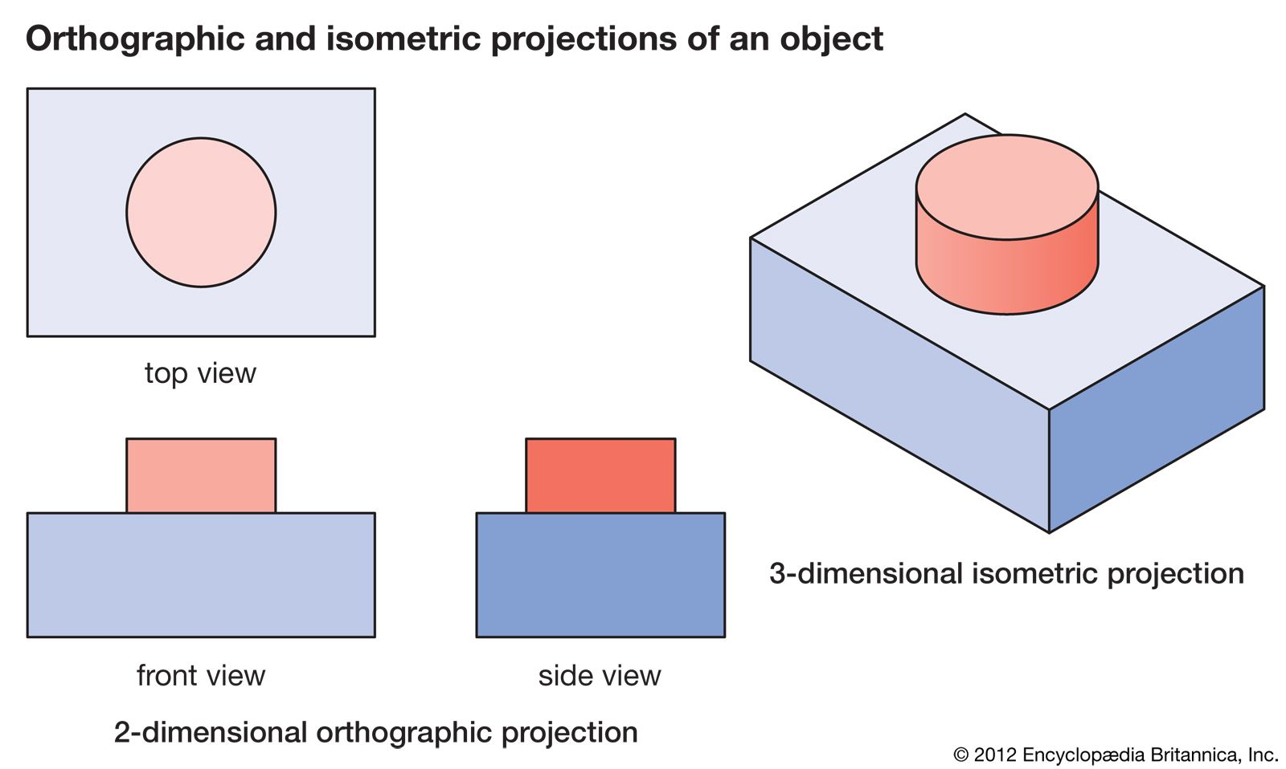
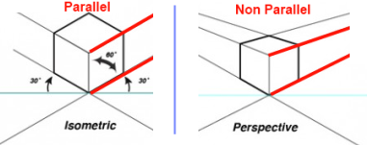
Projections
Types of Projections:
Orthographic (Multiview): Front, top, side views (first-angle vs. third-angle projection)
Isometric: 3D representation with equal axes (30° angles)
Perspective: Realistic 3D view

Slide 10
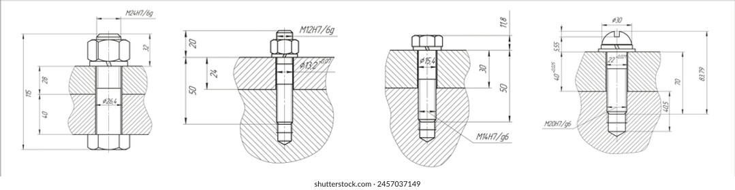
Part Drawings
Key elements:
  Dimensions (tolerances, units)
  Surface finish symbols
  Material specifications
  Title block (author, scale, date)

Slide 11
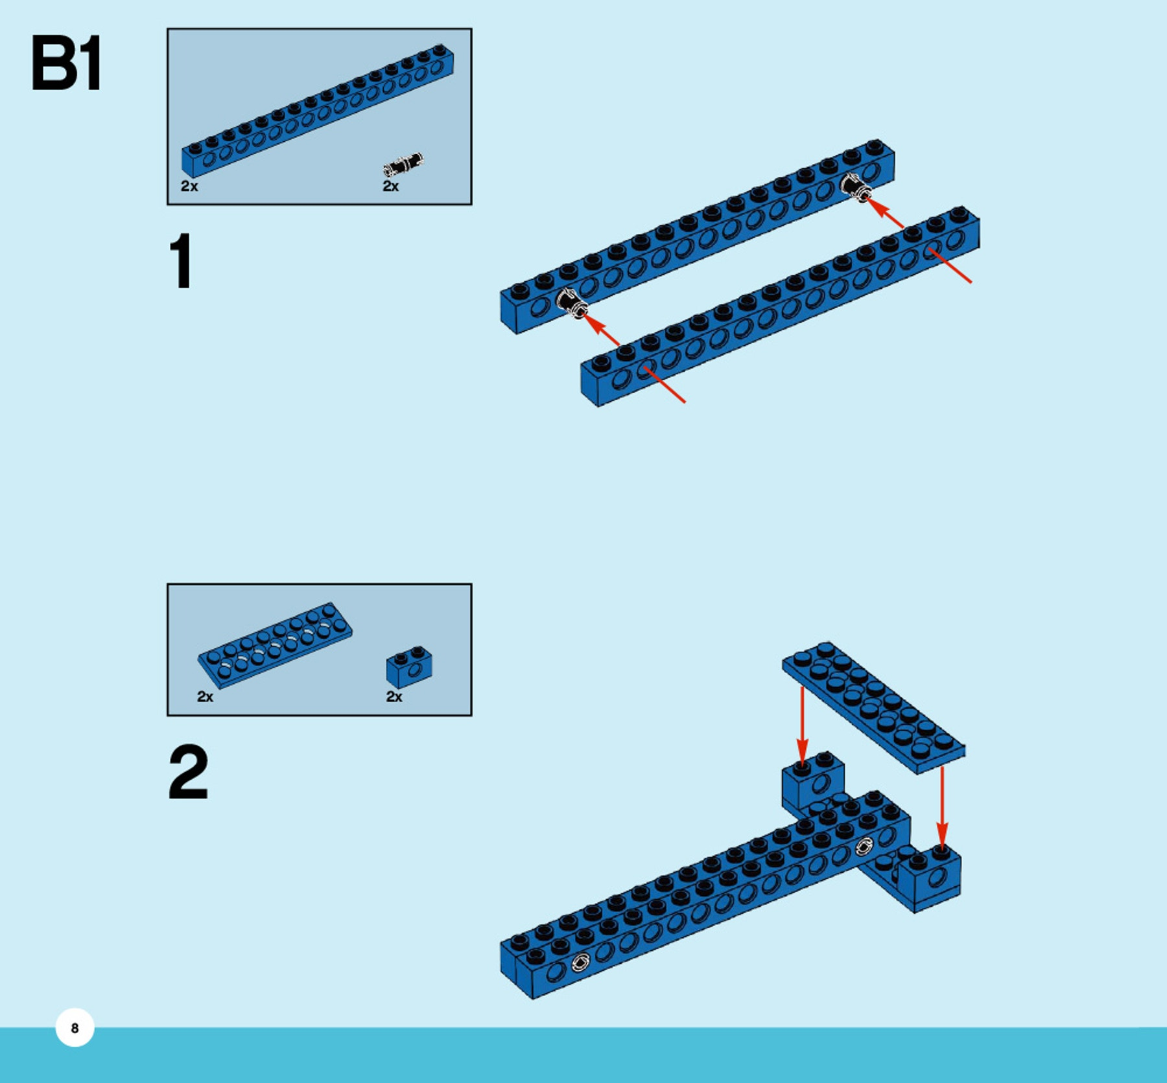
Assembly Drawings
Definition: Illustrates how multiple parts fit together in a product or system
Purpose:
  Shows relationships between components
  Guides assembly, maintenance, or disassembly
Key Elements:
  Exploded Views: Separated parts aligned to show assembly order
  Bill of Materials: List of parts with quantities and IDs
  Assembly Instructions: Notes or arrows for critical steps

Slide 12
Graphical Conventions
Standard Practices
Line Types:
  Continuous (visible edges)
  Dashed (hidden features)
  Centerlines (symmetry/axes)
Symbols:
  Surface finish, welding, electrical
Annotations:
  Dimensions, notes, leaders

Slide 13

draw.io: Your Tool for Engineering Diagrams
What is draw.io?
  Free, web-based diagramming tool for technical and engineering drawings
Why Use draw.io?
  Supports standardized symbols (electrical, logic, mechanical)
  Collaborative (real-time sharing via Google Drive, OneDrive, etc.)
  Export as PNG, PDF, or integrate into docs
Let’s open draw.io!
Download from here

Slide 14
Schematics: Blueprints of Functionality
Definition:
  A schematic is a symbolic diagram that represents a system’s functionality (not physical layout)
  Uses standardized symbols to show components and connections.
Purpose:
  Communicate how a system works (electrical flow, logic, fluid dynamics).
  Critical for design, troubleshooting, and documentation.
Key Elements:
  Symbols: Resistors, transistors, gates, valves (abstractions of real components).
  Connections: Lines/wires showing flow or relationships.
  Labels: Values (e.g., 10kΩ), voltages, signal names.

Slide 15
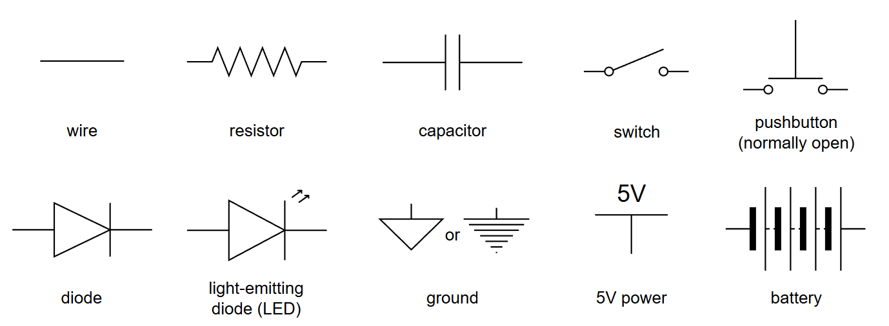
Schematic conventions in circuits
There are a variety of standards used by electrical engineers to define the appearance of many common circuit elements.
Credit: Carnegie Mellon University (courses.ideate.cmu.edu)

Slide 16
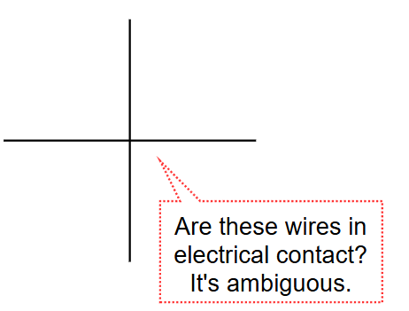
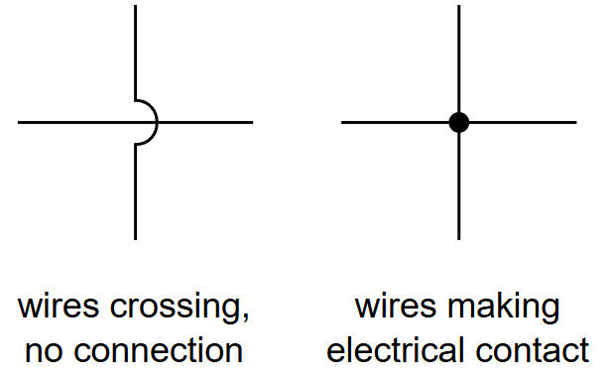
Wire crossing style
Credit: Carnegie Mellon University (courses.ideate.cmu.edu)

Slide 17
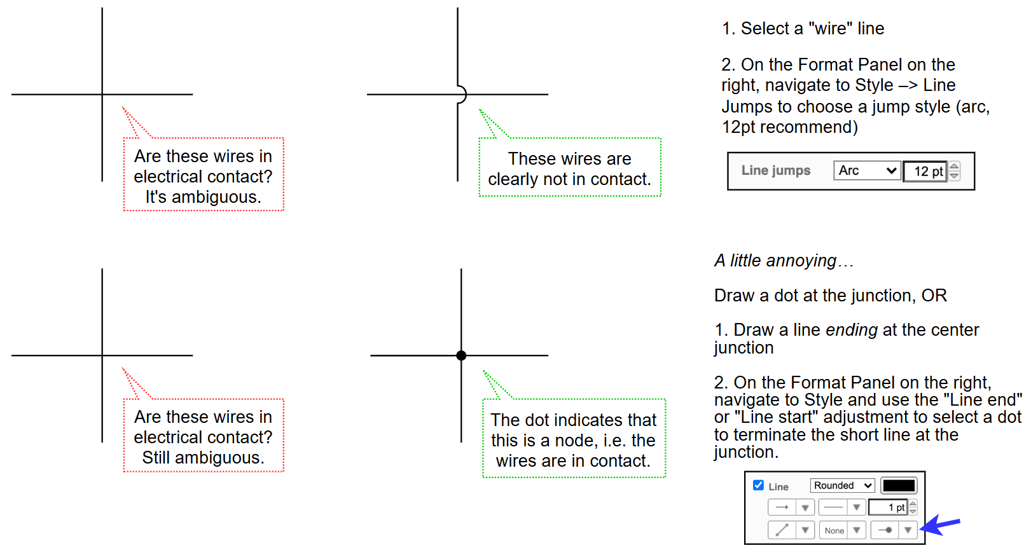
Wire crossing style: How
Credit: Carnegie Mellon University (courses.ideate.cmu.edu)

Slide 18
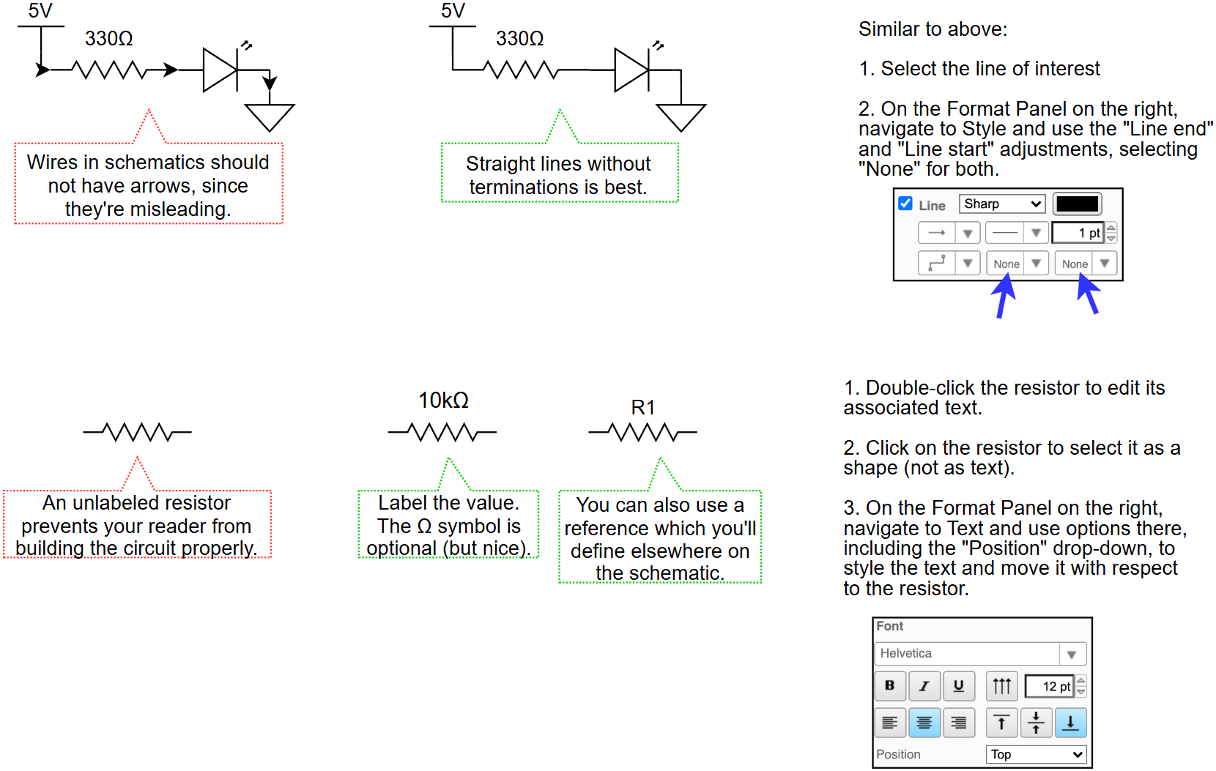
Some Do’s and Do Not Do’s
Credit: Carnegie Mellon University (courses.ideate.cmu.edu)

Slide 19
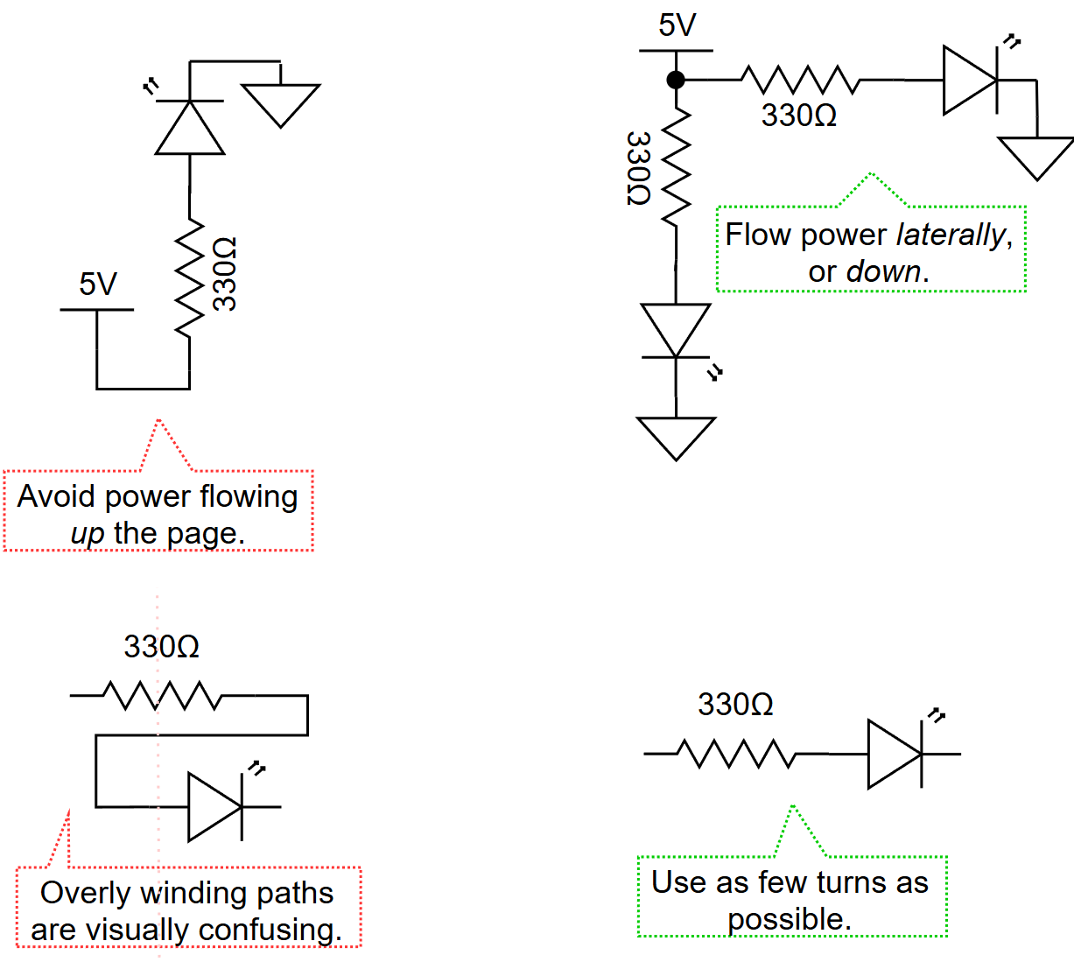
Some Do’s and Do Not Do’s (contd.)
Credit: Carnegie Mellon University (courses.ideate.cmu.edu)

Slide 20
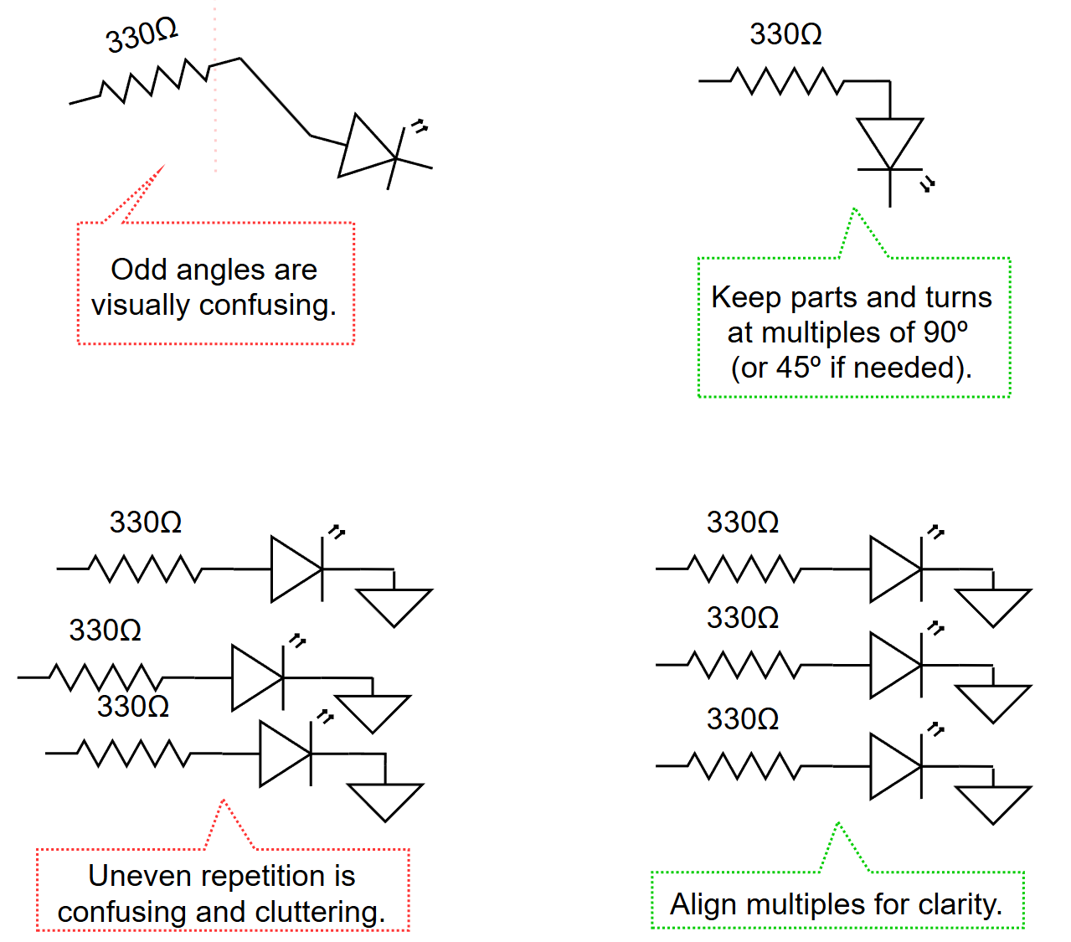
Some Do’s and Do Not Do’s (contd.)
Credit: Carnegie Mellon University (courses.ideate.cmu.edu)

Slide 21
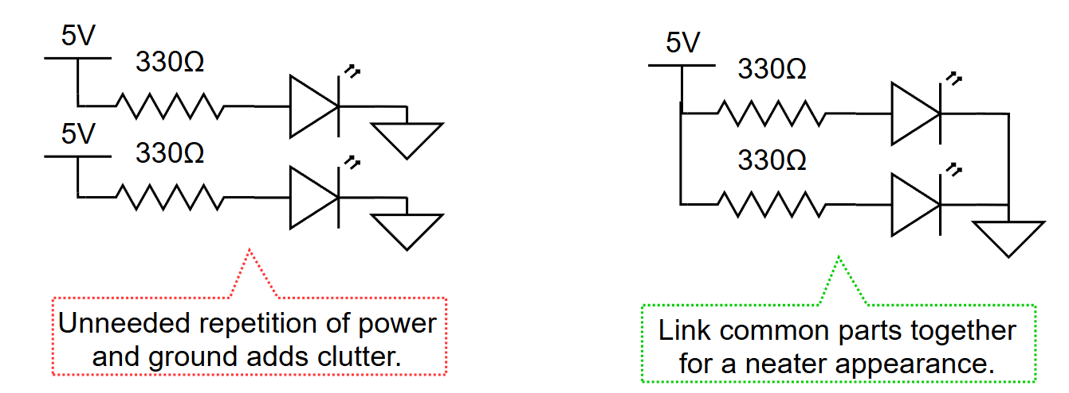
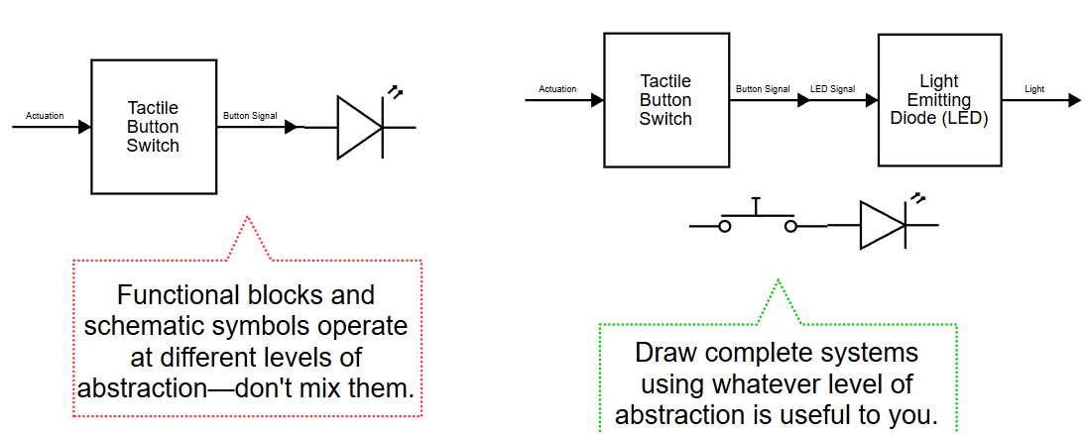
Some Do’s and Do Not Do’s (contd.)
Credit: Carnegie Mellon University (courses.ideate.cmu.edu)

Slide 22
Some Do’s and Do Not Do’s (contd.)
Credit: Carnegie Mellon University (courses.ideate.cmu.edu)

Slide 23
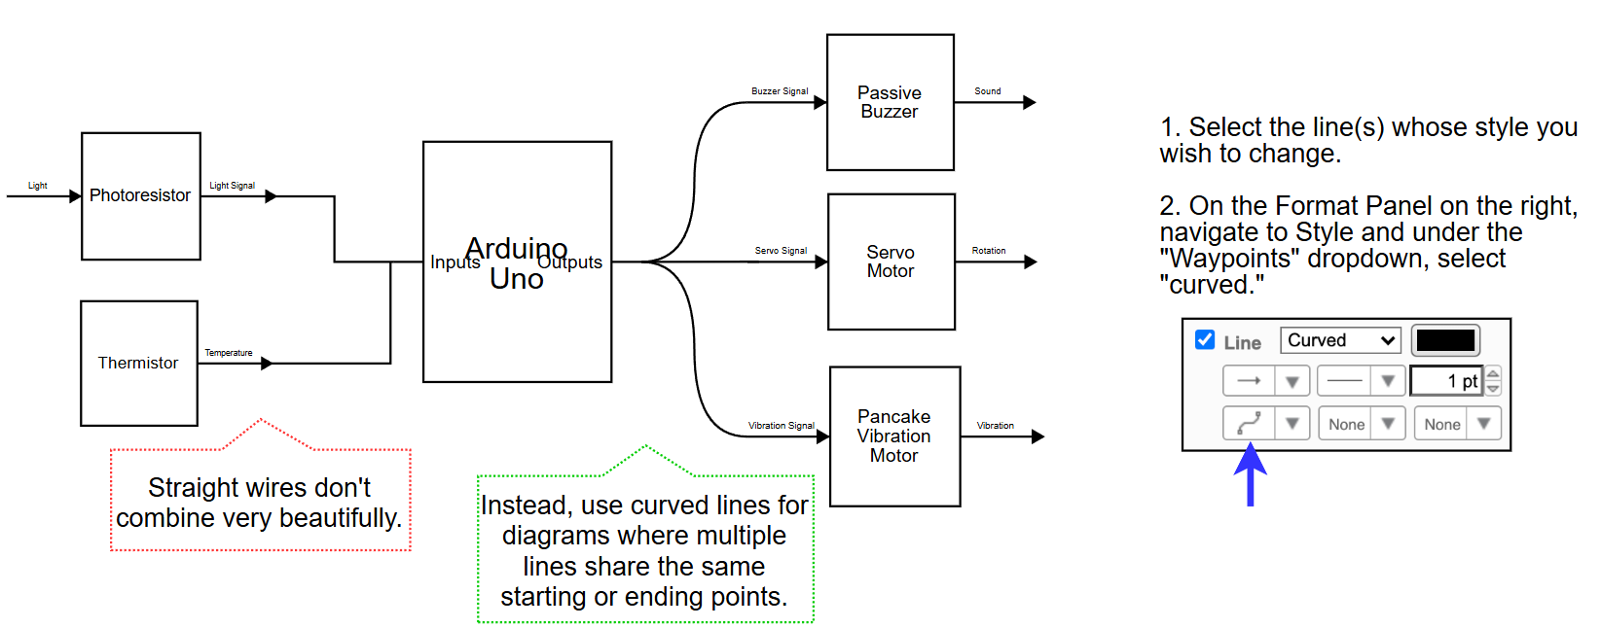
Some Do’s and Do Not Do’s (contd.)
Credit: Carnegie Mellon University (courses.ideate.cmu.edu)

Slide 24
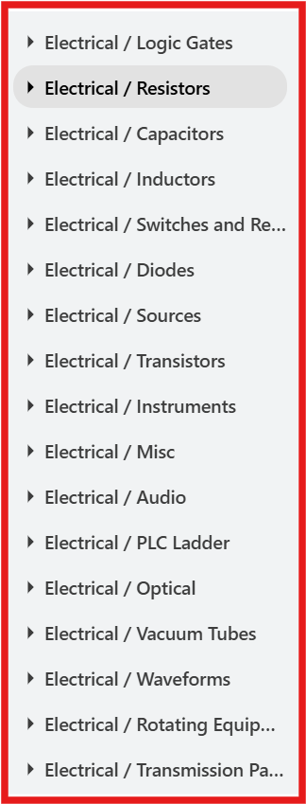
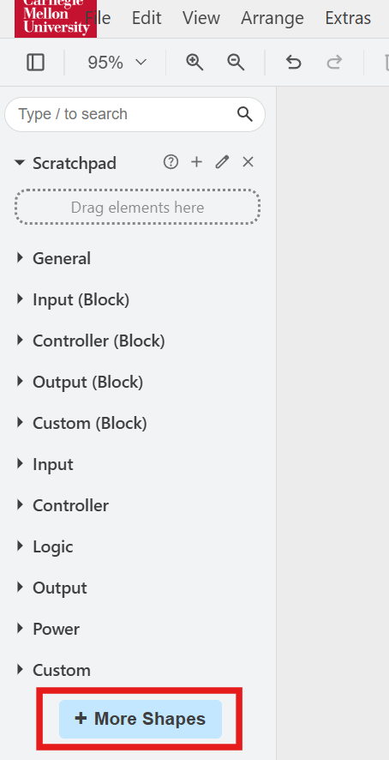
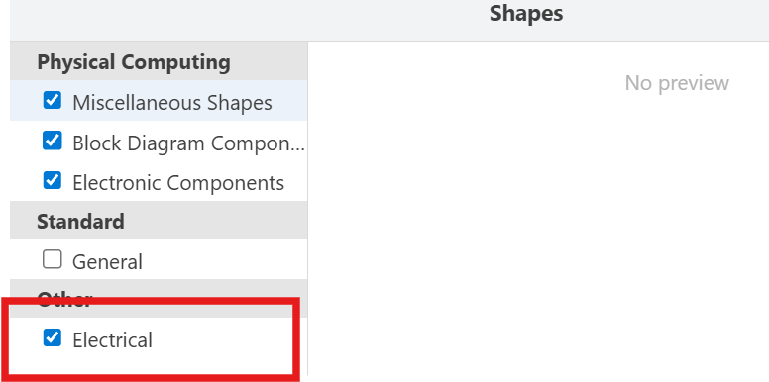
How to obtain circuit elements?

Slide 25
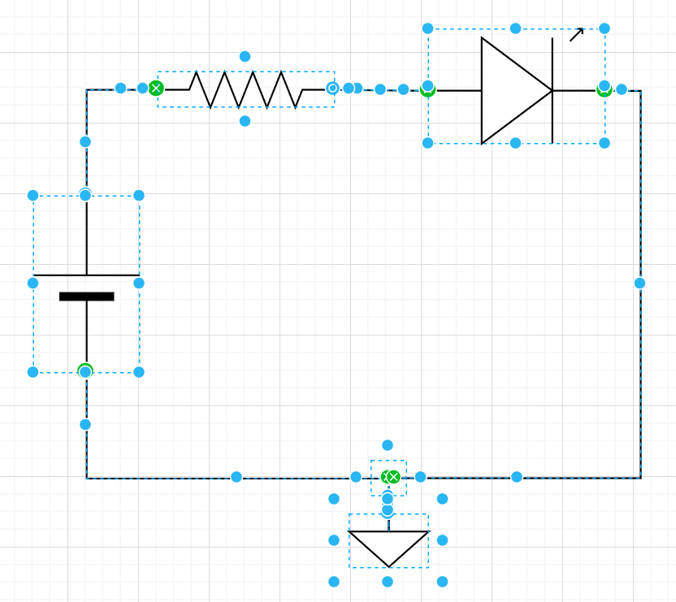
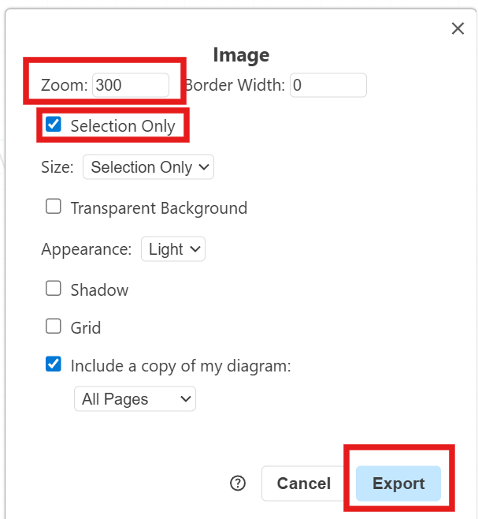
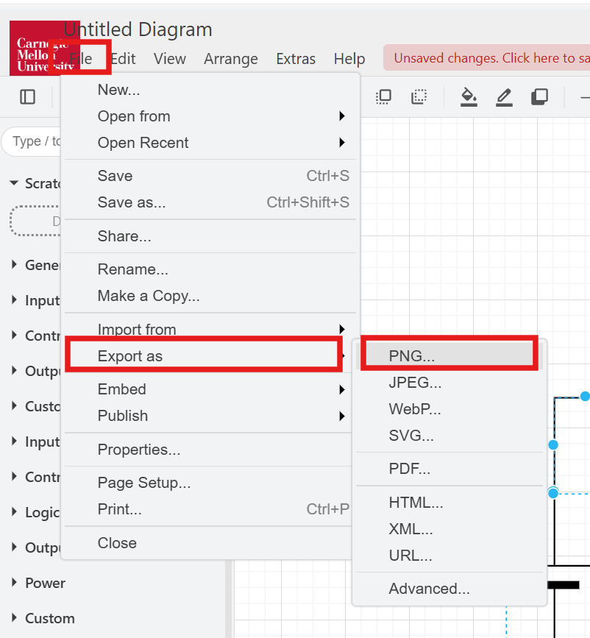
How to save into images?
1. Press Ctrl + A to select all the elements in the figure
3. Select the following options and click on Export
to save your file in the desired location
2. Go to File > Export as > PNG/JPEG

Slide 26
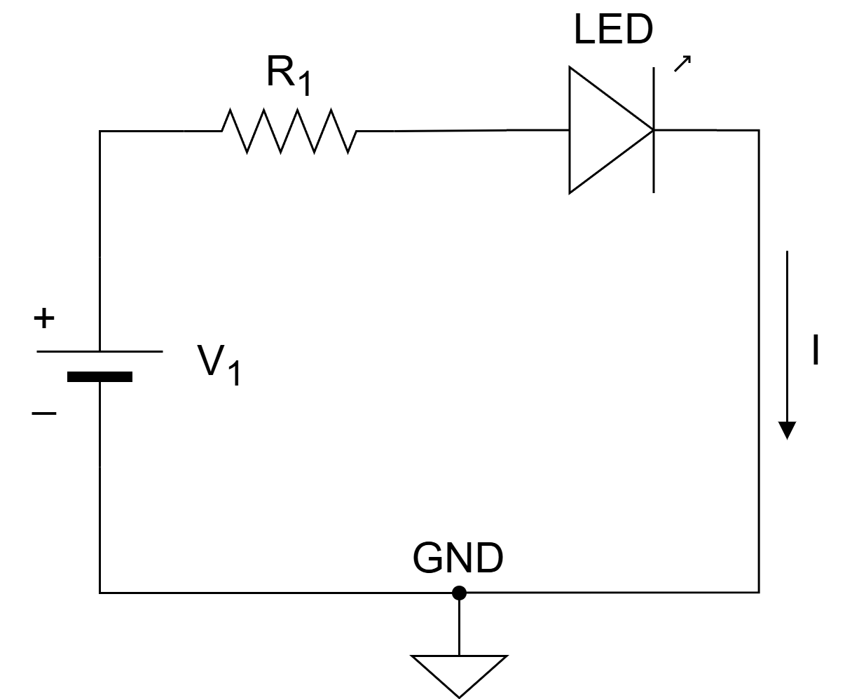
Exercise#1

Slide 27
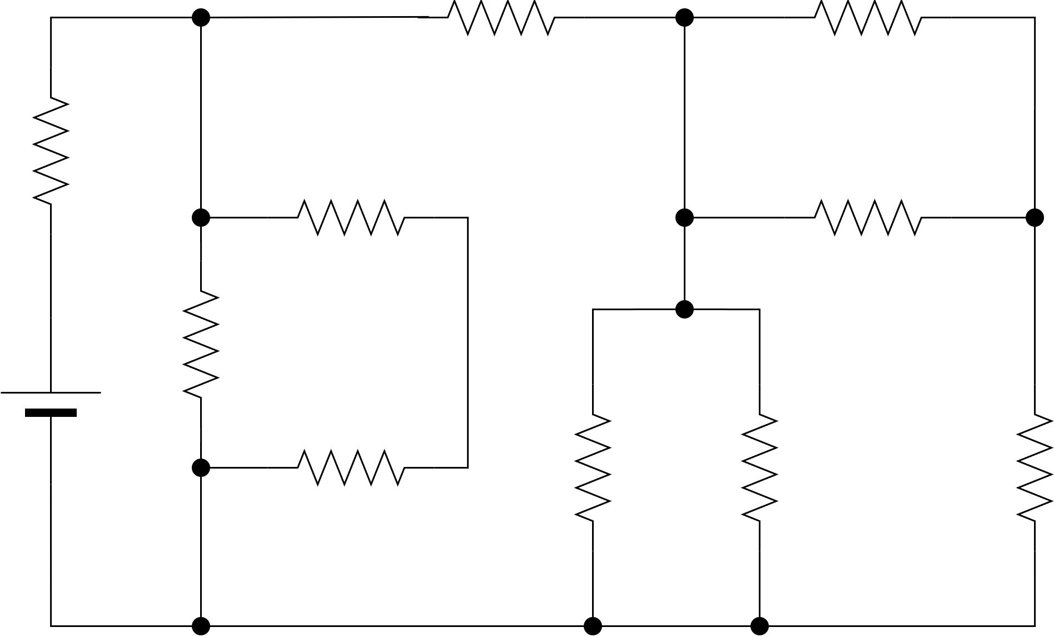
Exercise#2

Slide 28
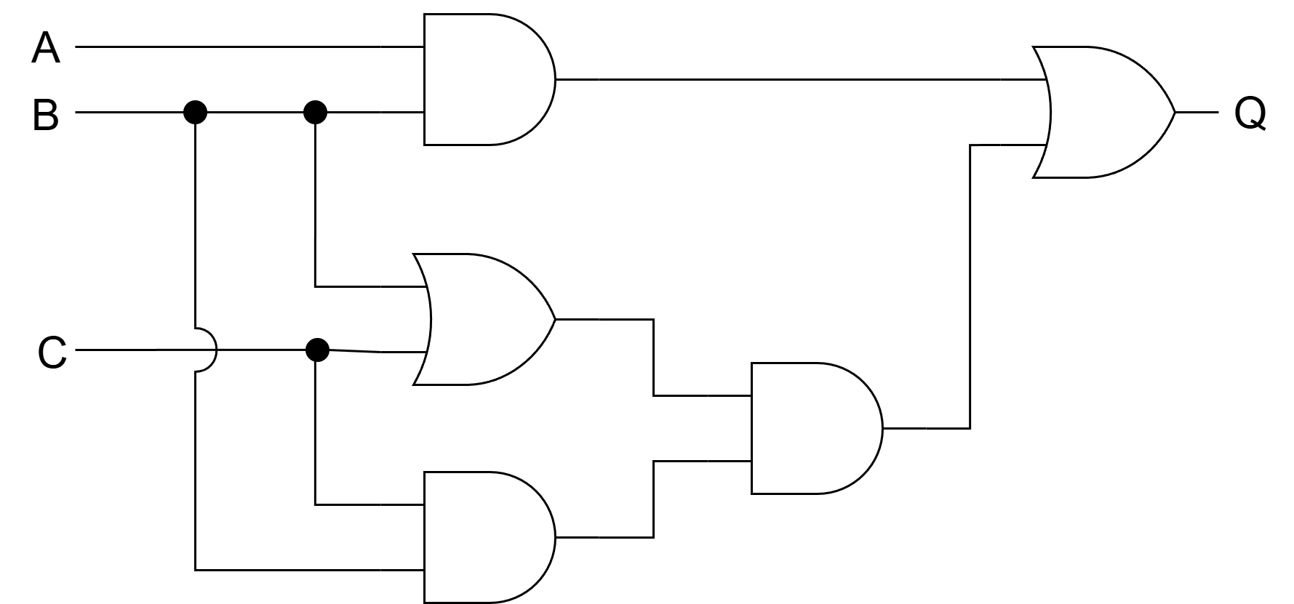
Exercise#3

